Slide 1
PRINCIPLES OF DRUG ADDICTION TREATMENT
Dr. K. S. NJUGUNA

Slide 2
WHAT IS DRUG ADDICTION?
Drug addiction is a complex illness characterised by compulsive, and at times, uncontrollable drug craving, seeking, and use that persist even in the face of extremely negative consequences.
(NIDA, 1999)
Addiction is a brain disease that is chronic and relapsing in nature.

Slide 3
VOLUNTARY
DRUG USE
Compulsive
Drug Use
(Addiction)

Slide 4
ADDICTION IS, FUNDAMENTALLY,
A
BRAIN DISEASE
...BUT
IT’S NOT JUST A BRAIN DISEASE

Slide 5

INTERACTIVE MODEL OF DRUG USE
Drug
Route, effects, actions,
purity, potency, quality
Form, price, availability,
interaction with other drugs,
previous experience
The Drug Use Experience
Environment
Individual
Physical / emotional reaction,
mood, current health, age,
tolerance, knowledge, beliefs, memories, expectations
Where, when, who, how, employment, social context,
supply, peers, legality, culture,
media, advertising, availability

Slide 6
FACTORS THAT INFLUENCE DRUG USE
There are at least three different categories of factors to consider:
  predisposing factors
  precipitating (enabling) factors
  perpetuating (reinforcing) or maintaining factors

Slide 7
ADDICTION TREATMENT GOALS
The goals of addiction treatment are to help the individual:
  Stop or reduce the use of drugs
  Reduce the harm related to drug use
  Achieve productive functioning in their family, at work, and in society

Slide 8
COMPREHENSIVE ADDICTION TREATMENT
Why comprehensive addiction treatment ?
Addicted individuals usually suffer from mental health, occupational, health, or social problems that make their addictive disorder difficult to treat
For most people, treatment is a long-term process that involves multiple interventions and attempts at abstinence

Slide 9
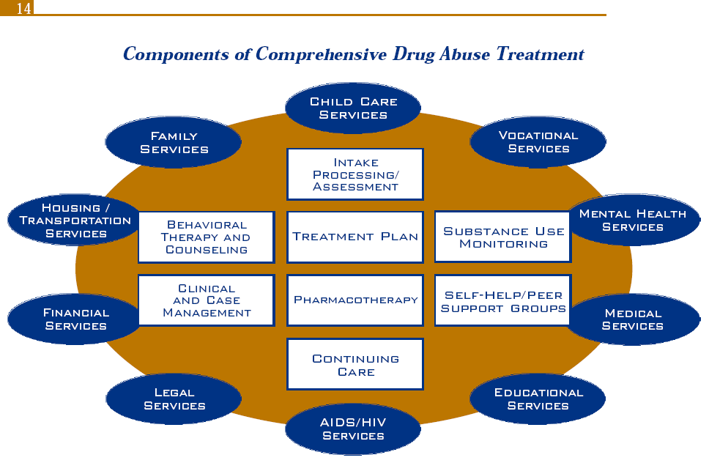
COMPONENTS OF COMPREHENSIVE DRUG ABUSE TREATMENT

Slide 10
TREATMENT DURATION
Individuals progress through drug addiction treatment at various speeds, so there is no predetermined length of treatment.
In general, longer treatment duration results in better outcomes.

Slide 11
TREATMENT COMPLIANCE
Client factors that affect treatment compliance are:
  Readiness to change drug-using behaviour
  Degree of support from family and friends
  Pressure to stay in treatment from the criminal justice system, child protection services, an employer, or family members

Slide 12
TREATMENT COMPLIANCE
Factors within the program that affect treatment compliance are
  A positive therapeutic relationship between the counsellor and client
  A clear treatment plan, which allows the client to know what to expect during treatment
  Medical, psychiatric, and social services
  Medication available when appropriate
  Transition to continuing care or “aftercare”

Slide 13
HUMAN RESOURCES FOR DRUG ADDICTION TREATMENT
Drug addiction treatment is offered in specialized facilities and mental health clinics by a variety of professionals such as:
  Medical doctors
  Psychiatrists
  Nurses
  Psychologists
  Social workers
  Case managers
  Certified drug abuse counsellors
  Other substance abuse professionals

Slide 14
PRINCIPLES OF EFFECTIVE TREATMENT
NO single treatment is APPROPRIATE FOR ALL
Treatment needs to be READILY AVAILABLE
Effective treatment attends to MULTIPLE NEEDS, not just to drug use problems
The treatment plan must be ASSESSED CONTINUALLY and MODIFIED AS NECESSARY to insure that it meets the client’s changing needs
Remaining in treatment for an ADEQUATE PERIOD OF TIME is critical for treatment effectiveness.

Slide 15
PRINCIPLES OF EFFECTIVE TREATMENT
Counselling (individual and/or group) and other behavioural therapies are CRITICAL
Medications are IMPORTANT elements of treatment for many clients, especially when combined with behavioural therapy
People with coexisting mental disorders should be treated in AN INTEGRATED way
Detoxification is only the FIRST STAGE of addiction treatment and by itself does little to change long-term drug use.

Slide 16
PRINCIPLES OF EFFECTIVE TREATMENT
Treatment does NOT need to be voluntary to be effective
Possible drug use during treatment must be MONITORED continuously
Treatment programs should provide assessment for HIV/AIDS and other infectious diseases as well as counselling to help clients change behaviours that place themselves or others at risk of infection
Recovering from drug addiction can be a LONG-TERM PROCESS and frequently requires multiple episodes of treatment

Slide 17
PRINCIPLES OF EFFECTIVE TREATMENT
An addiction treatment professional should:
  Respect the client
  Be a role model
  Control the therapeutic relationship
  Emphasise the client’s personal responsibility for recovery
  Provide direction and encourage self-direction
  Be conscious of his or her own issues

Slide 18
ETHICAL ISSUES
Ethical Values:
Be good!
Do good!
And above all: Do no harm!

Slide 19
ETHICAL ISSUES
The client’s rights and the limits of confidentiality should be explained at the beginning of treatment
The relationship with any client should be private and confidential
Client information should not be communicated outside of the treatment team
Information should only be released with the client’s or guardian’s permission
Confidentiality must be maintained at all times, except when to do so could result in harm to the client or others.

